Slide 1
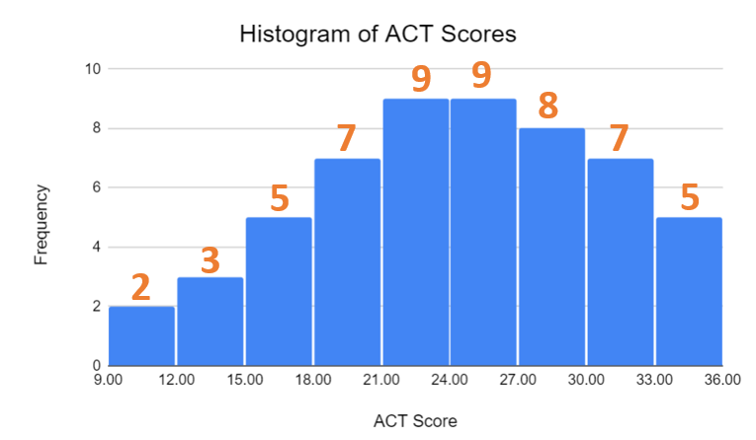
Median in Histogram

Slide 2
Describe the boxplots

Slide 3
How to read boxplots?
1
2
3
4
5
6
7
8
9
10
11
12
13
14

Slide 4
Q1
Q3
Median
1
2
3
4
5
6
7
8
9
10
11
12
13
14

Slide 5
Min
Q1
Q3
Max
Median
1
2
3
4
5
6
7
8
9
10
11
12
13
14

Slide 6
Min
Q1
Q3
Max
Median
1
2
3
4
5
6
7
8
9
10
11
12
13
14
Outliers

Slide 7
IQR
Min
Q3
Q1
Max
Median
1
2
3
4
5
6
7
8
9
10
11
12
13
14
Outliers

Slide 8
Right Skew
Left Skew

Slide 9
Describe the distribution…
Salaries at a Company
$0
$25,000
$50,000
$75,000
$100,000
$125,000
$150,000
$175,000
$200,000
Salaries ($)
Context: Subject of data
Shape: Skew (not modes)
Outlier: Dots
Center: Median
Spread: IQR

Slide 10
Salaries at a Company
$0
$25,000
$50,000
$75,000
$100,000
$125,000
$150,000
$175,000
$200,000
Salaries ($)
Data was collected on salaries at a company.
The distribution appears to be right skewed.
The median of the distribution is $34,500.
There are two high outliers, at $67,000 and $185,000.
The IQR is $7,000.

Slide 11
Compare two distributions

Slide 12
A
B
$0
$1,000
$2,000
$3,000
$4,000
$5,000
$6,000
$7,000
Household Tax Cut Amounts ($)
Compare these distributions…

Slide 13
A
B
$0
$1,000
$2,000
$3,000
$4,000
$5,000
$6,000
$7,000
Household Tax Cut Amounts ($)
Compare these distributions…
1. Use CSOCS
2. Use comparative language for each feature
- “less than”, “greater than”, “similar”

Slide 14
A
B
$0
$1,000
$2,000
$3,000
$4,000
$5,000
$6,000
$7,000
Household Tax Cut Amounts ($)
Compare these distributions…
Applies to dotplots, stemplots, histograms, and boxplots!
1. Use CSOCS
2. Use comparative language for each feature
- “less than”, “greater than”, “similar”

Slide 15
A
B
$0
$1,000
$2,000
$3,000
$4,000
$5,000
$6,000
$7,000
Household Tax Cut Amounts ($)
Compare these distributions…

Slide 16
A
B
$0
$1,000
$2,000
$3,000
$4,000
$5,000
$6,000
$7,000
Household Tax Cut Amounts ($)
Compare these distributions…
C (Context) –
S (Shape) –
O (Outlier) –
C (Center) –
S (Spread) –

Slide 17
A
B
$0
$1,000
$2,000
$3,000
$4,000
$5,000
$6,000
$7,000
Household Tax Cut Amounts ($)
Compare these distributions…
C (Context) – tax cuts ($) under two plans
S (Shape) –
O (Outlier) –
C (Center) –
S (Spread) –

Slide 18
A
Compare these distributions…
C (Context) – tax cuts ($) under two plans
S (Shape) –
O (Outlier) –
C (Center) –
S (Spread) –

Slide 19
A
Compare these distributions…
C (Context) – tax cuts ($) under two plans
S (Shape) –
O (Outlier) –
C (Center) –
S (Spread) –

Slide 20
A
Compare these distributions…
C (Context) – tax cuts ($) under two plans
S (Shape) – A is slightly left skew,
O (Outlier) –
C (Center) –
S (Spread) –

Slide 21
B
Compare these distributions…
C (Context) – tax cuts ($) under two plans
S (Shape) – A is slightly left skew,
O (Outlier) –
C (Center) –
S (Spread) –

Slide 22
B
Compare these distributions…
C (Context) – tax cuts ($) under two plans
S (Shape) – A is slightly left skew, B is right skew
O (Outlier) –
C (Center) –
S (Spread) –

Slide 23
A
B
$0
$1,000
$2,000
$3,000
$4,000
$5,000
$6,000
$7,000
Household Tax Cut Amounts ($)
Compare these distributions…
C (Context) – tax cuts ($) under two plans
S (Shape) – A is slightly left skew, B is right skew
O (Outlier) –
C (Center) –
S (Spread) –

Slide 24
A
B
$0
$1,000
$2,000
$3,000
$4,000
$5,000
$6,000
$7,000
Household Tax Cut Amounts ($)
Compare these distributions…
C (Context) – tax cuts ($) under two plans
S (Shape) – A is slightly left skew, B is right skew
O (Outlier) – A has no outliers, B has high outliers
C (Center) –
S (Spread) –

Slide 25
A
B
$0
$1,000
$2,000
$3,000
$4,000
$5,000
$6,000
$7,000
$200
$1,400
Household Tax Cut Amounts ($)
Compare these distributions…
C (Context) – tax cuts ($) under two plans
S (Shape) – A is slightly left skew, B is right skew
O (Outlier) – A has no outliers, B has high outliers
C (Center) – Medians are about $200 and $1,400
S (Spread) –

Slide 26
$1,500
A
B
$400
$0
$1,000
$2,000
$3,000
$4,000
$5,000
$6,000
$7,000
Household Tax Cut Amounts ($)
Compare these distributions…
C (Context) – tax cuts ($) under two plans
S (Shape) – A is slightly left skew, B is right skew
O (Outlier) – A has no outliers, B has high outliers
C (Center) – Medians are about $200 and $1,400
S (Spread) – IQRs are about $1,500 and $400

Slide 27
A
B
$0
$1,000
$2,000
$3,000
$4,000
$5,000
$6,000
$7,000
Household Tax Cut Amounts ($)
Compare these distributions…
Household tax cuts ($) under Plan A are slightly left-skewed, whereas they are severely right-skewed under Plan B. There are no outliers under Plan A, while there are many outliers higher than $1,250 in Plan B. The median tax cut under Plan A (about $1,400) is higher than
under Plan B (about $200). Plan A also has a higher IQR
(about $1,500) than Plan B (about $400).

Slide 28
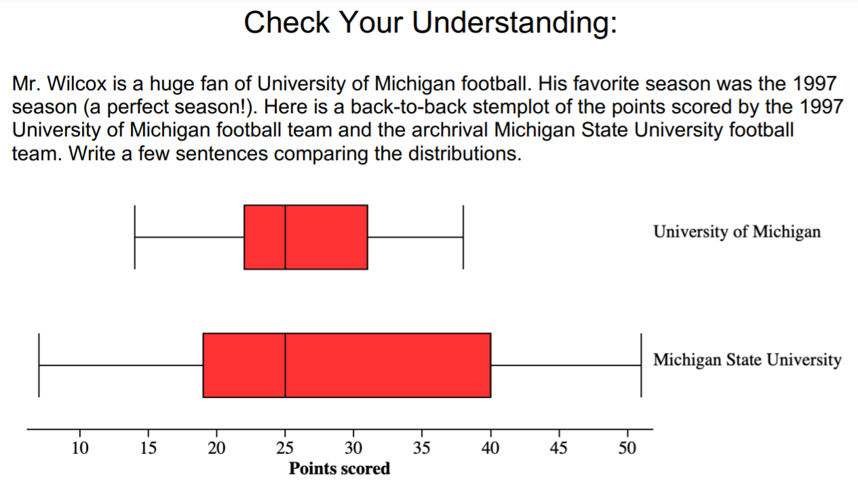
Have a try!

Slide 29
The distribution of points scored by University of Michigan (UOM) is roughly symmetric while the distribution of points scored by Michigan State University (MSU) is slightly skewed to the right.
The centers of both UOM and MSU are the same with medians of 25 points.
Neither UOM nor MSU have any outliers.
MSU has much greater variability than UOM with an IQR of about 22 as opposed to UOM’s IQR of about 9 points.

Slide 30
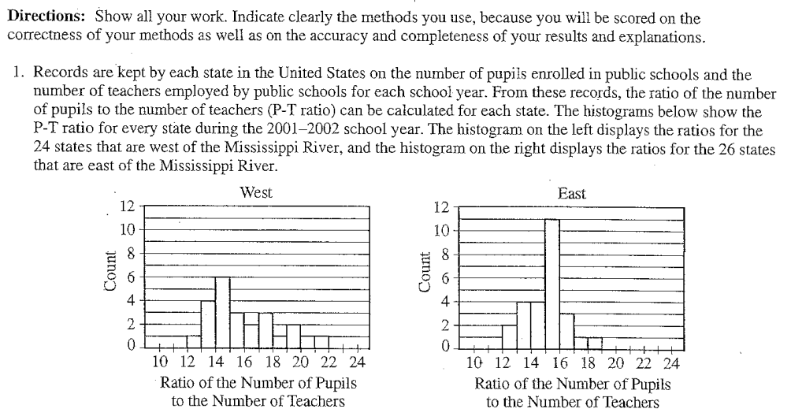

Slide 31
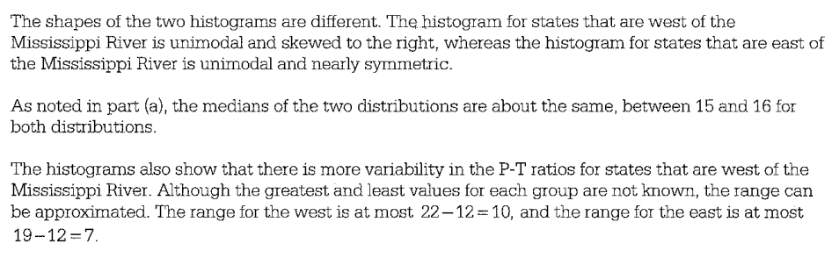

Slide 32
Lecture 8 Describing quantitative data variance, standard deviation

Slide 33
Measuring Spread: The Standard Deviation
how far each observation is from the mean.
Consider the following data on the number of pets owned by a group of 9 children.
Calculate the mean.
Calculate each deviation.
deviation = observation – mean
deviation: 1 - 5 = - 4
deviation: 8 - 5 = 3
= 5

Slide 34
Measuring Spread: The Standard Deviation
x_{i} | (x_{i}-mean) | (x_{i}-mean)²
1 | 1 - 5 = -4 | (-4)² = 16
3 | 3 - 5 = -2 | (-2)² = 4
4 | 4 - 5 = -1 | (-1)² = 1
4 | 4 - 5 = -1 | (-1)² = 1
4 | 4 - 5 = -1 | (-1)² = 1
5 | 5 - 5 = 0 | (0)² = 0
7 | 7 - 5 = 2 | (2)² = 4
8 | 8 - 5 = 3 | (3)² = 9
9 | 9 - 5 = 4 | (4)² = 16
 | Sum=? | Sum=?
3) Square each deviation.
4) Find the “average” squared deviation. Calculate the sum of the squared deviations divided by (n-1)…this is called the variance.
5) Calculate the square root of the variance…this is the standard deviation.
“average” squared deviation = 52/(9-1) = 6.5 This is the sample variance.
Standard deviation = square root of variance =

Slide 35
Measuring Spread: The Standard Deviation
The standard deviation s_{x} or s measures the average distance of the observations from their mean. It is calculated by finding an average of the squared distances and then taking the square root.
The average squared distance is called the variance.
df

Slide 36
Divide by n–1?
 | Samples of size 2 | mean | variance using n-1 | variance using n
1 | 1, 1 | 1 | 0 | 0
2 | 1, 2 | 1.5 | 0.5 | 0.25
3
4
5
6
7
8
9
Average

Slide 37
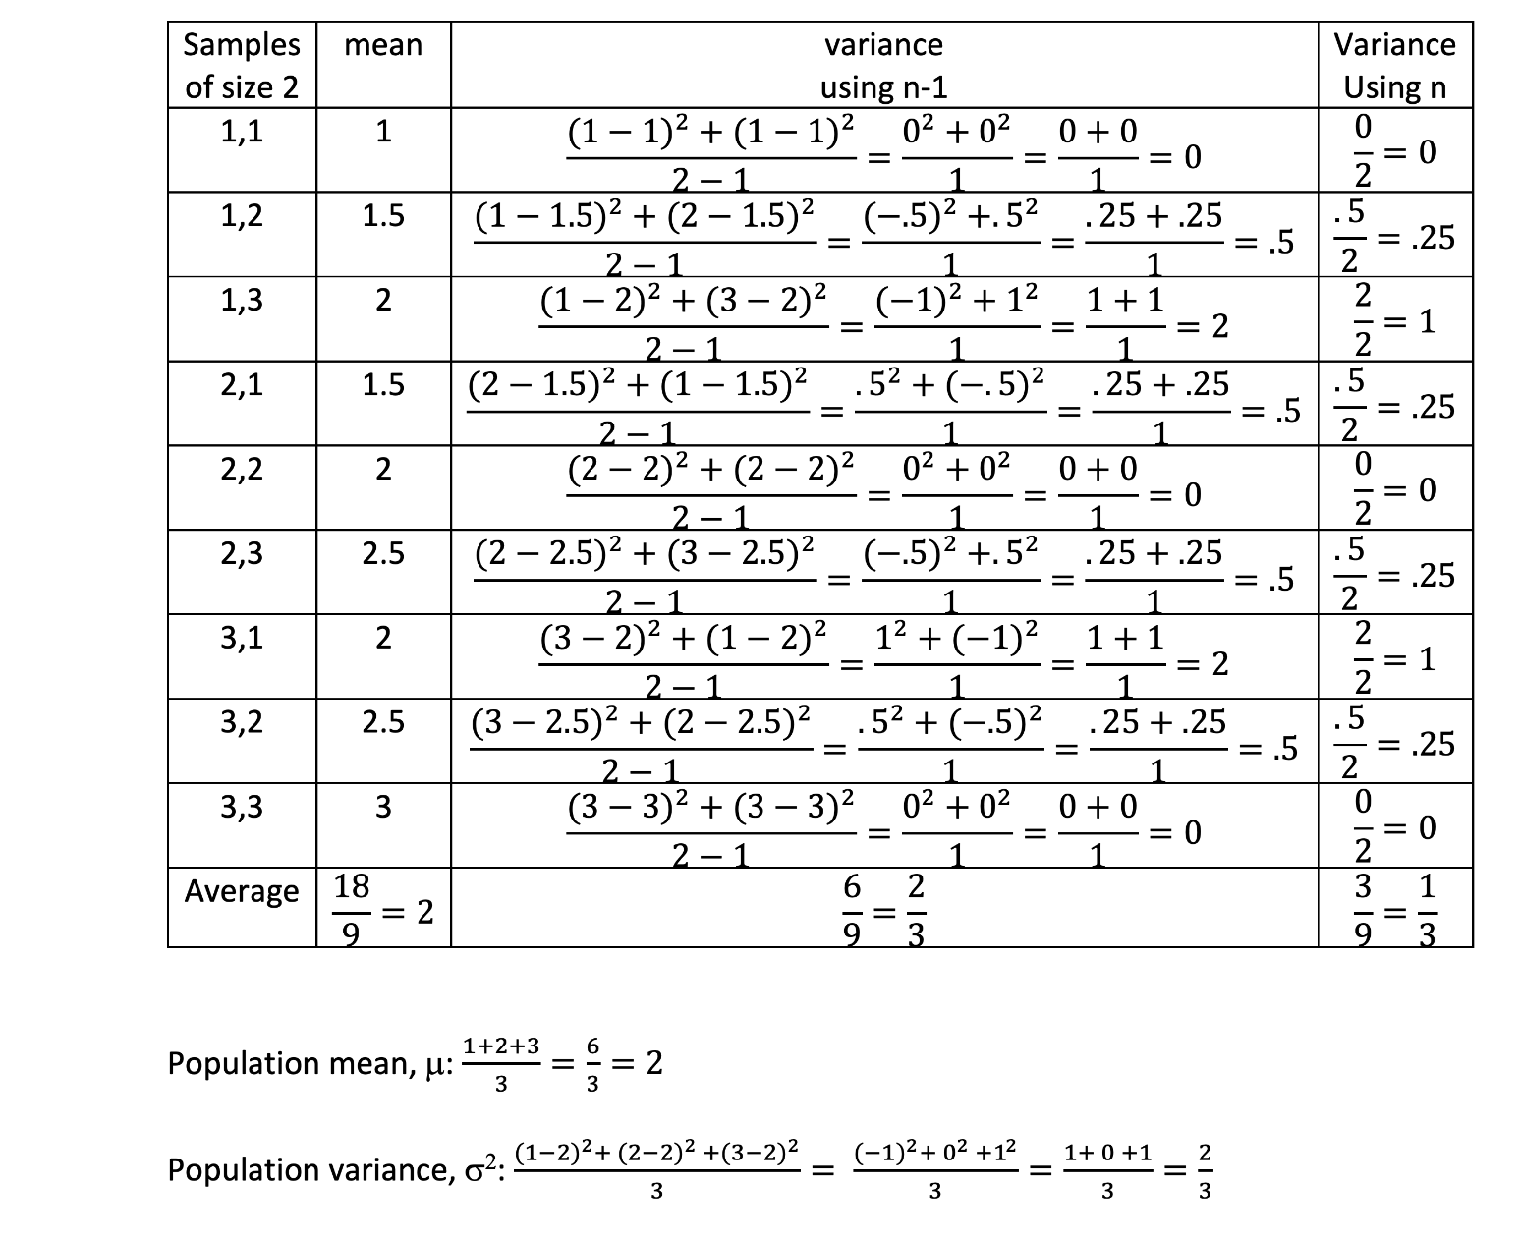
1.7

